Slide 1
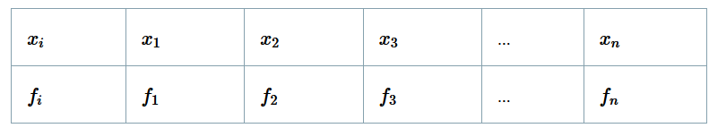
Discrete Frequency Distribution
In statistics, we deal with different kinds of data in huge amounts.
We require the data to be arranged in such a way that one can perform suitable statistical experiments.
Thus we group into two ways, namely, discrete and continuous frequency distribution.
These groupings help us in finding mean, median and mode.
Discrete Frequency Distribution is defined as the grouping of a discrete data provided with respect to their frequencies.
Discrete Frequency Distribution Table
A tally chart is a simple way of counting and recording the frequency of any given data.

Slide 2
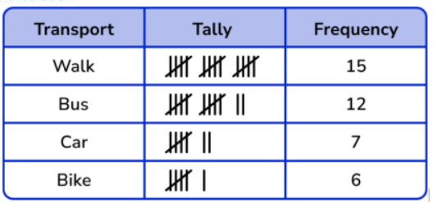

Slide 3
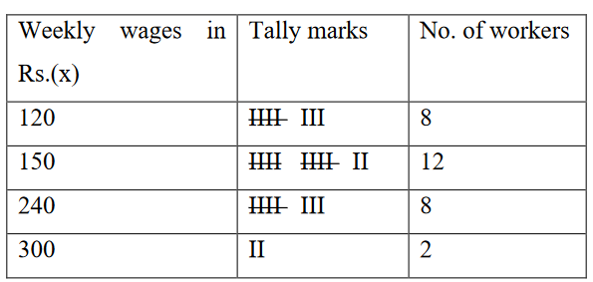
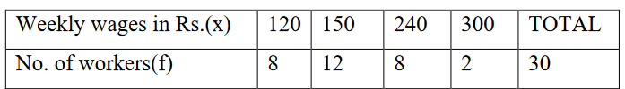
1) Discrete frequency distribution
In discrete frequency distribution, values of the variable is arranged individually. The frequencies of the various values are the number of times each value occurs.
The weekly wages in Rs. paid to the workers are given below. Form a discrete frequency distribution
300,240,240.150,120,240,120,120,150,150,150,240,150,150,120,300,120,150,240,150,150,120,240,150,240,150,120,120,240,150.

Slide 4
2) Continuous frequency distribution
Continuous frequency distribution is also known as grouped frequency distribution.
This is a form in which class intervals and respective class frequencies are given.
We can find frequency distribution by the following steps:
• First of all, calculate the range of the data set.
• Next, divide the range by the number of the group you want your data in and then round up.
• After that, use class width to create groups
• Finally, find the frequency for each group

Slide 5
Let us consider the following example regarding daily maximum temperatures in in
a city for 50 days
28, 28, 31, 29, 35, 33, 28, 31, 34, 29,
25, 27, 29, 33, 30, 31, 32, 26, 26, 21,
21, 20, 22, 24, 28, 30, 34, 33, 35, 29,
23, 21, 20, 19, 19, 18, 19, 17, 20, 19,
18, 18, 19, 27, 17, 18, 20, 21, 18, 19.

Slide 6
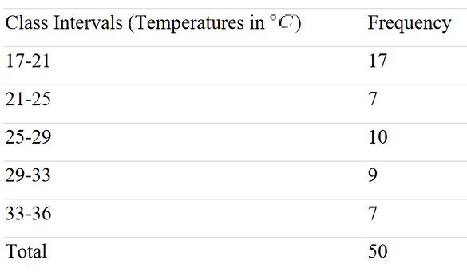
• Minimum Value= 17
• Maximum Value=35
• Range=35-17=18
• Number of classes=5 (say)
• width of each class=4
Table Showing frequency distribution
of temperature in a city for 50 days.

Slide 7
Terms used in continuous frequency distribution
Class Interval: The whole range of variable values is classified in some groups in the form of intervals. Each interval is called a class interval.
Class Frequency: The number of observations in a class is termed as the frequency of the class or class frequency.
Class limits and Class boundaries:Class limits are the two endpoints of a class interval which are used for the construction of a frequency distribution.
the class 17-21, the lower-class limit is 17 and the upper-class limit is 21.

Slide 8
Size/length of the Class: The length of the class is called the class width. It is also known as class size.
Class interval or size of the class = U.C.B. – L.C.B.
U.C.B. is Upper Class Boundary
L.C.B. is Lower Class Boundary
Mid-point/class mark of the Class: The midpoint of a class interval is called Mid-point of the Class. It is the representative value of the entire class.
Mid-point of the class = (U.C.B. +L.C.B.)/2

Slide 9
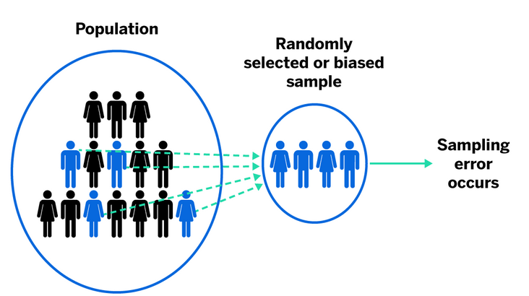
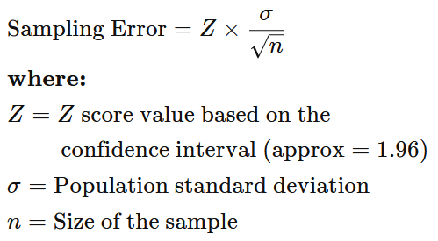
Sampling Error
A sampling error is a statistical error that occurs when an analyst does not select a sample that represents the entire population of data. As a result, the results found in the sample do not represent the results that would be obtained from the entire population.

Slide 10
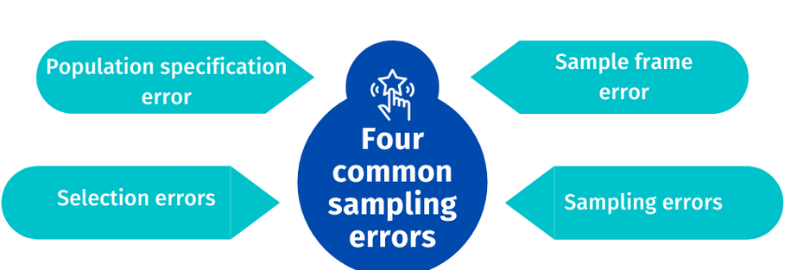
Types of common sampling error
Population specification error
A population specification error occurs when researchers don’t know precisely who to survey.
For example, imagine a research study about kid’s apparel. Who is the right person to survey? It can be both parents, only the mother, or the child. The parents make purchase decisions, but the kids may influence their choice.
Sample frame error
Sampling frame error occurs when researchers target the sub-population wrongly while selecting the sample.
For example, picking a sampling frame from the telephone white pages book may have erroneous inclusions because people shift their cities. Erroneous exclusions occur when people prefer to un-list their numbers. Wealthy households may have more than one connection, thus leading to multiple inclusions.

Slide 11
Types of common sampling error
Selection error
Selection error occurs when respondents self-select themselves to participate in the study. You can control selection errors by going the extra step to request responses from the entire sample. Only interested ones respond.
Pre-survey planning, follow-ups, and a neat and clean survey design will boost respondents’ participation rate. Also, try sampling methods like CATI surveys and in-person interviews to maximize responses.
Sampling errors
Sampling errors occur due to a disparity in the representativeness of the respondents. It majorly happens when the researcher does not plan his sample carefully.
These sampling errors can be controlled and eliminated by creating a careful sample design, having a large enough sample to reflect the entire population, or using an online sample or survey audiences to collect responses.

Slide 12
Absolute Error and Relative errors
Absolute Error
The absolute error is the difference between the measured value and the actual value.
The absolute error value can be determined using the formula if ‘a’ is the actual value of a quantity and ‘e’ is the measured/estimated value of the quantity.
absolute error =a-e.
For example, if you measure the length of a room and get a measurement of 10 feet, but the true length of the room is 12 feet, then the absolute error is 2 feet.
For example: Suppose that the actual value of a measurement is 10.25 cm and the measured value of that measurement is 11.05 cm.
Then, the value of absolute error is |a – e| i.e. |11.05-10.25|= 0.80 cm.

Slide 13
Absolute Error and Relative errors
Relative Error
Relative error is a measure of the size of the error in a measurement relative to the size of the measurement itself. Relative error is always expressed as a percentage.
Relative Error is defined as the difference between the true value and the estimated value, divided by the true value.
The relative error is always between 0 and 1.
relative error = absolute error / actual value= (a-e)/a
suppose that an eraser’s true length is 35 mm and the measured length of the eraser is 34.13 mm. The absolute inaccuracy is now (0.87 mm) = (35-34.13) mm.
As a result, the relative error equals to absolute error/actual length= 0.87/35= 0.02485.

Slide 14

Systematic sampling
Systematic sampling is a type of probability sampling that selects items of data at regular intervals from a population.
sampling interval/sampling ratio (k)
E.g.
If the population size is 1200 and the desired sample size is 400 items of data, we divide 1200 by 400 to get an interval of 3.
This means that every 3rd item of data in the ordered list is selected for the sample.

Slide 15
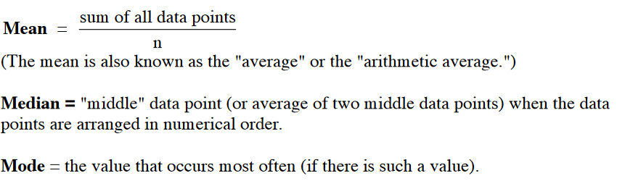
MEASURES of CENTRAL TENDENCY
A measure of central tendency is a number that represents the typical value in a collection of numbers. Three familiar measures of central tendency are the mean, the median, and the mode.
We will let n represent the number of data points in the distribution. The

Slide 16
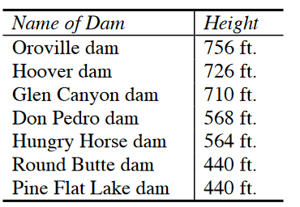
MEASURES of CENTRAL TENDENCY
Compute the mean, median and mode for the following DAM STATISTICS
MEAN = (756 + 726 + 710 + 568 + 564 + 440 + 440)/7
= 4204/7 = 600.57
In order to find the median we must first list the data points in numerical order:
756, 726, 710, 568, 564, 440, 440
Now we choose the number in the middle of the list.
756, 726, 710, 568, 564, 440, 440
The median is 568.
Since the number 440 occurs more often than any of the other numbers on this list, the mode is 440.

Slide 17
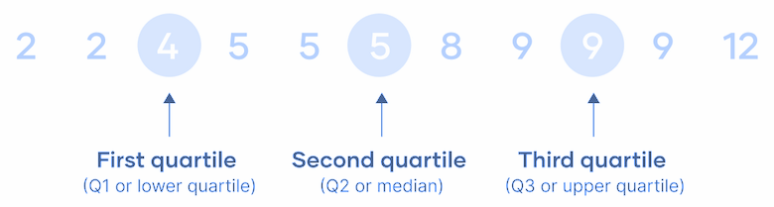
Quartiles & Quantiles
Quartiles are three values that split sorted data into four parts, each with an equal number of observations. Quartiles are a type of quantile.
The first quartile (Q1, or the lowest quartile) is the 25th percentile, meaning that 25% of the data falls below the first quartile.
The second quartile (Q2, or the median) is the 50th percentile, meaning that 50% of the data falls below the second quartile.
The third quartile (Q3, or the upper quartile) is the 75th percentile, meaning that 75% of the data falls below the third quartile.

Slide 18
Quartiles & Quantiles
By splitting the data at the 25th, 50th, and 75th percentiles, the quartiles divide the data into four equal parts.
In a sample or dataset, the quartiles divide the data into four groups with equal numbers of observations.
In a probability distribution, the quartiles divide the distribution’s range into four intervals with equal probability.
first quartile: Count the number of observations in the dataset (n)
Calculate n * (1 / 4).
If n * (1 / 4) is an integer, then the first quartile is the mean of the numbers at positions n * (1 / 4) and n * (1 / 4) + 1.
If n * (1 / 4) is not an integer, then round it up. The number at this position is the first quartile.
second quartile:
Calculate n * (2 / 4).
If n * (2 / 4) is an integer, the second quartile is the mean of the numbers at positions n * (2 / 4) and n * (2 / 4) + 1.
If n * (2 / 4) is not an integer, then round it up. The number at this position is the
third quartile:
Calculate n * (3 / 4).
If n * (3 / 4) is an integer, then the third quartile is the mean of the numbers at positions n * (3 / 4) and n * (3 / 4) + 1.
If n * (3 / 4) is not an integer, then round it up. The number at this position is the third quartile.

Slide 19
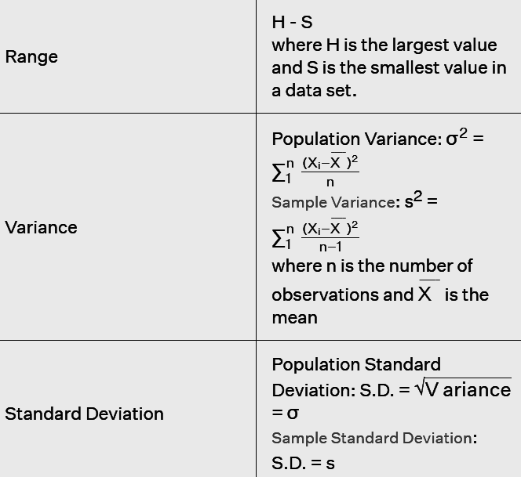
Measures of dispersion
Measures of dispersion help to describe the variability in data.
Dispersion is a statistical term that can be used to describe the extent to which data is scattered.
Thus, measures of dispersion are certain types of measures that are used to quantify the dispersion of data.
Absolute Measures of Dispersion

Slide 20
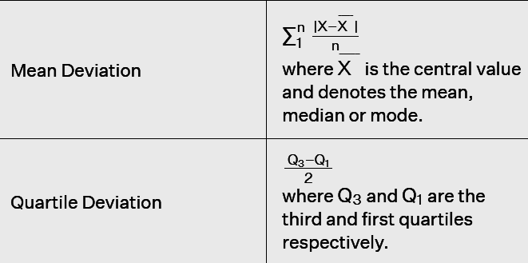
Measures of dispersion

Slide 21

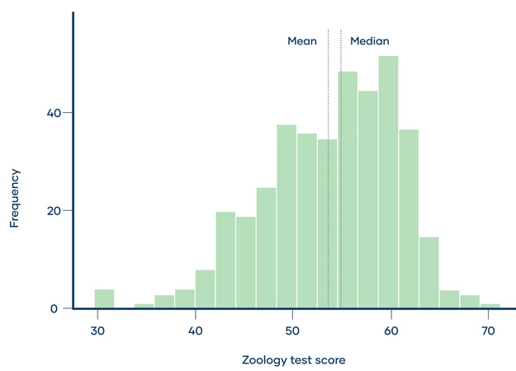
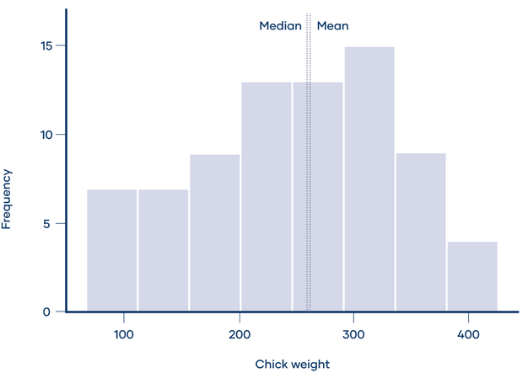
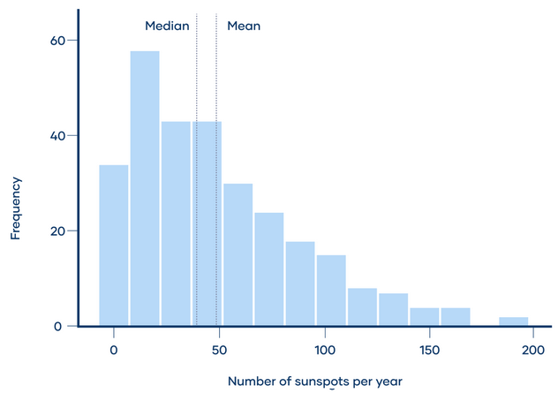
Skewness
Skewness is a measure of the asymmetry of a distribution. A distribution is asymmetrical when its left and right side are not mirror images.
A distribution can have right (or positive), left (or negative), or zero skewness.
A right-skewed distribution is longer on the right side of its peak, and a left-skewed distribution is longer on the left side of its peak
In a distribution with zero skew, the mean and median are equal
Zero skew: mean = median
Right skew: mean > median
Left skew: mean < median

Slide 22
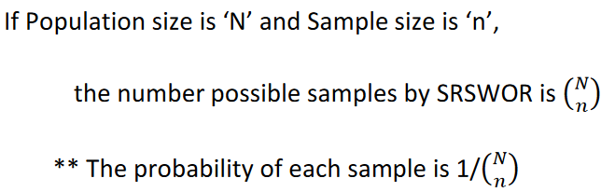
Simple Random Sample (SRS)
A Simple Random Sample calculator uses two methods – SRSWOR and SRSWR.
Simple random sample without replacement (SRSWOR):
units are drawn from the population one by one by without replacing the selected units in the previous draw in to the population before the next draw giving equal chance.

Slide 23
Simple Random Sample (SRS)
SRSWR, units are drawn from the population one by one by
replacing the selected units in the previous draw in to the population before
the next draw giving equal chance.
If Population size is ‘N’ and Sample size is ‘n’,
the number possible samples by SRSWOR is N n
** The probability of each sample is 1/ Nn
** The probability of a specified unit being included in the sample is n/N

Slide 24
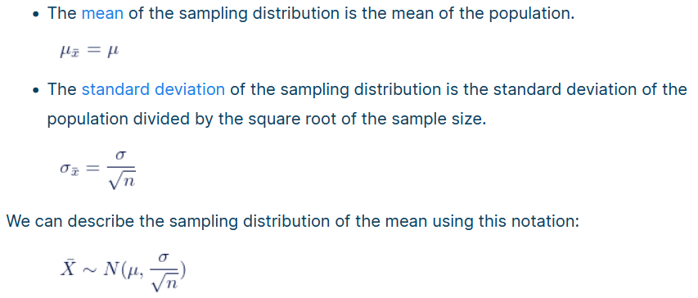
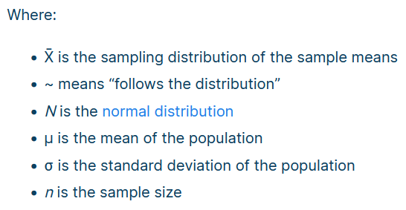
Central Limit Theorem
The central limit theorem states that if you take sufficiently large samples from a population, the samples’ means will be normally distributed, even if the population isn’t normally distributed.

Slide 25
Central Limit Theorem
1. Sample size and normality
The larger the sample size, the more closely the sampling distribution will follow a normal distribution.
When n < 30, the central limit theorem doesn’t apply. The sampling distribution will follow a similar distribution to the population. Therefore, the sampling distribution will only be normal if the population is normal.
When n ≥ 30, the central limit theorem applies. The sampling distribution will approximately follow a normal distribution.

Slide 26
Central Limit Theorem
Conditions of the central limit theorem
The central limit theorem states that the sampling distribution of the mean will always follow a normal distribution under the following conditions:
The sample size is sufficiently large. This condition is usually met if the sample size is n ≥ 30.
The samples are independent and identically distributed (i.i.d.) random variables. This condition is usually met if the sampling is random.
The population’s distribution has finite variance. Central limit theorem doesn’t apply to distributions with infinite variance, such as the Cauchy distribution. Most distributions have finite variance.

